Slide 1


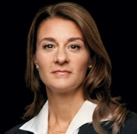


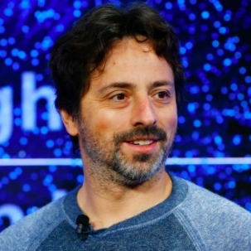






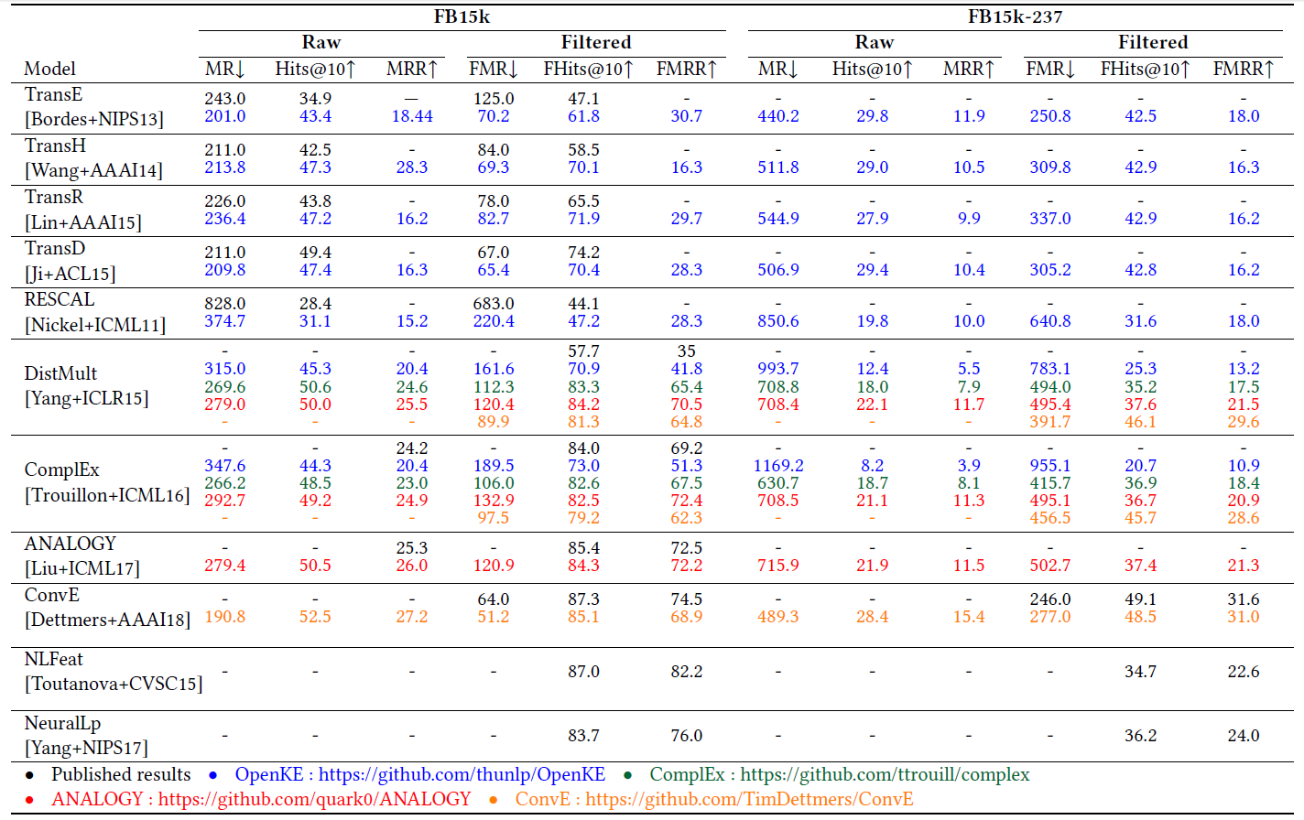


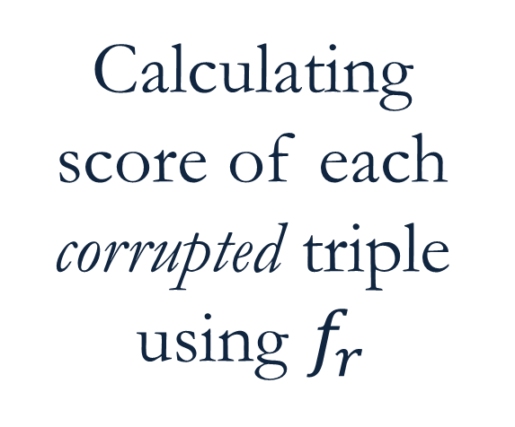
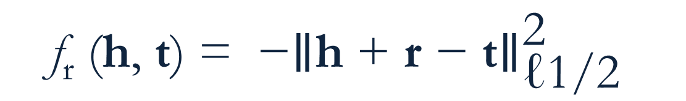
Re-evaluating Embedding-Based Knowledge Graph Completion Methods
Farahnaz Akrami¹, Lingbing Guo², Wei Hu², Chengkai Li¹
University of Texas at Arlington¹, Nanjing University²
Motivation
Importance of Knowledge Graphs (KG) for many AI-related applications such
as question answering, web search, and fact checking.
Incompleteness of KGs despite their large sizes.
Popularity of embedding models among various KG completion methods.
Prevalence use of the benchmark dataset FB15k to evaluate embedding methods.
Existence of a bias in FB15k. It contains many pairs of (h, r, t) and (t, r⁻¹, h) where r⁻¹ is inverse of r. Therefore, the inverse of numerous test triples occurs in the training set.
No previous investigation of the effect of the aforementioned bias in the results of embedding-based knowledge graph completion methods.
Melinda Gates
Nationality
Stanford
Spouse
Nationality
Sergey Brin
Education
Bill Gates
Founded
Google
Founded
Headquarter
Satya Nadella
CEO
Microsoft
Mountain View
Headquarter
Redmond
Embedding-Based Models
Benchmark Datasets
Steps employed by embedding-based methods :
defining a scoring function to measure the plausibility of triples (h,r,t).
Learning the representations of h, r, and t by solving an optimization problem of maximizing the scores of correct triples while minimizing the scores of incorrect ones.
FB15k [Bordes+NIPS13]: A subset of Freebase extensively employed for evaluating KG embedding approaches. Inverse triples of 81% of the test triples exist in the training set [Toutanova+CVSC15].
FB15-237 [Toutanova+CVSC15]: A subset of FB15k created by removing inverse and near-duplicate relations from FB15k.
The very first embedding model
One of the simplest embedding methods
Vector representations of h, r, and t (h, r, t) are learned so if (h, r, t) holds then h+r ≈ t.
h+r ≈ t
film_genre
(h, r, t)= (Aliens, film_genre, Action Film)
TransE
[Bordes+NIPS13]
Aliens
Scoring function
Action Film
$$\text{f}\text{r}\text{ (}\text{h}\text{, }\text{t}\text{) = }{\text{−∥}\text{h}\text{ + }\text{r}\text{ − }\text{t}\text{∥}}_{\text{ℓ1/2} }^{\text{2}}$$
Link Prediction Task for Triples (h, r, t)
Reporting mean of predicted ranks (MR), mean reciprocal rank (MRR), percentage of test triples that are ranked within top 10 (Hits@10)
Replacing h/t entity with all available entities in the dataset to form corrupted triples
Calculating score of each corrupted triple using $f_{r}$
Sorting scores by ascending order
Storing rank of the correct entity
Results
Performance reduction of all methods on FB15k-237:
FMRR of ConvE
68.9 (on FB15k) to 31 (on FB15k-237)
Comparability of TransE on FB15k-237 to Many of its superior successors which outperformed TransE on FB15k:
Fhits@10 of ANALOGY vs TransE
84.3 vs 61.8 (on FB15k) to 37.4 vs 42.5 (on FB15k-237)
Superiority of ConvE results under many metrics.
Promising results of observed feature models NLFeat and NeuralLP.

